Slide 1
WORKSHOP
Recon with the Girl Squad

Slide 2





Lalithya Malyala
Mrigakshi Goel
Aarti Gadhia
Farah Hawa

Slide 3
Agenda
Basic Recon
Host Enumeration - [prerequisite: Kali linux, nmap (if not preinstalled)]
Subdomain Enumeration [prerequisite: sublist3r]
Google dorking

Slide 4
Before we begin
We have a set of questions for you!

Slide 5
Reconnaissance is the first step a Hacker/Pentester/Bug-bounty hunter will take
Job advertisements
Search engines like google, bing and yahoo
LinkedIn Facebook Twitter and the like
Whois search
Crunchbase for acquisitions
Wayback searches old urls

Slide 6
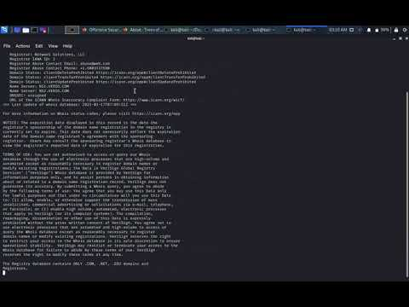
Whois
Notes:
Social engineering: This technique involves looking for reasoning to gain sensitive information or text by stimulating an individual mind or sense of social norms.
•
Dumpster diving: This technique involves obtaining sensitive information from trash locations.
•
Usenet tools: This technique depends on gathering data from company websites, gathering information from employees' social networks, or collecting some useful information from business partners.
•
Domain name system (DNS) reconnaissance–zone transfer: A DNS server can be a good place for hackers to harvest important information such as an address of a mail server, an address of a web server, operation system information, and even comments.

Slide 7
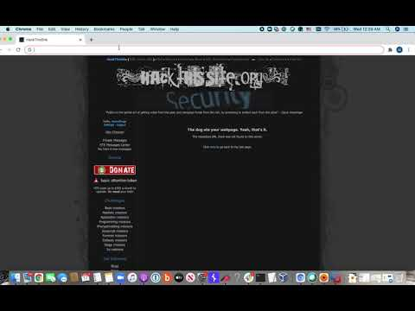
Manual Recon

Slide 8
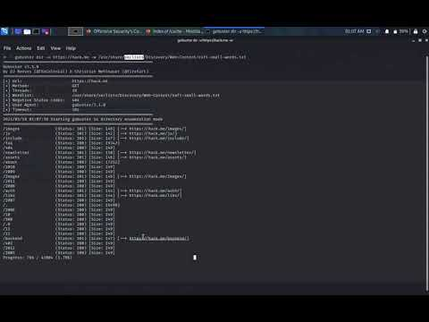

Slide 9
Basic Recon
IP range / CIDR
MXtoolbox / Domaintoipconverter
Favicon hashes
https://anywebsite/favicon.ico => favicon hash => search shodan.io
Format => http.favicon.hash: 709737812
SSL Certificates
Any website with an HTTPS web address uses SSL/TLS.

Slide 10
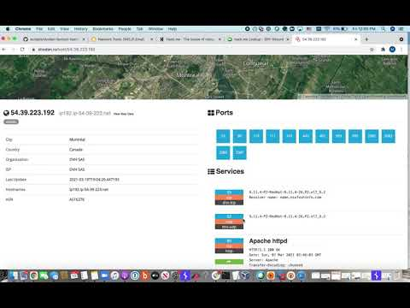
Quick Demo

Slide 11
Find out favicon hash of
https://google.com/favicon.ico

Slide 12
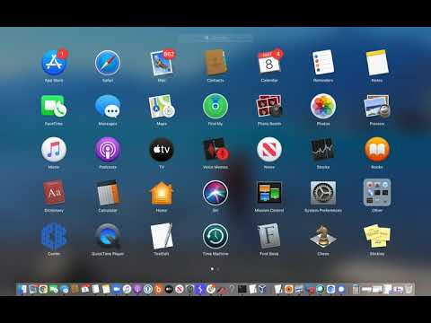
Answer

Slide 13
Host Discovery
~ Lalithya Malyala

Slide 14
Pre-requisite
Let’s do some recon in kali linux

Slide 15
Why do you want to discover a host?
Because you don’t know your target
Because you want to see other hosts present in network
Because you want to convert unmanaged host or targets to a managed list of host or targets on your network
This is what you want to recon on a network

Slide 16
Let’s discuss on some open source tools enumerating a Target
1.Host
2.Nmap
3.Nslookup
4.Httpstatus.io
5.Sub-domain Enumeration in CLI

Slide 17
Host
Host command in Linux system is used for DNS (Domain Name System) lookup operations. In simple words, this command is used to find the IP address of a particular domain name or if you want to find out the domain name of a particular IP address the host command becomes handy.
•Try: host 143.166.147.101
Check for it’s options to see how it works! ”man host”

Slide 18
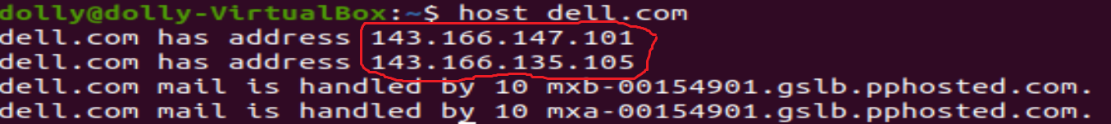

Slide 19
Nmap
Nmap is a fingerprinting tool used to find which devices are running on their network, discover open ports and services, and detect vulnerabilities.
Try: nmap dell.com
Check for it’s options to see how it works! ”man nmap”
To install:
sudo apt-get update
sudo apt-get install nmap
nmap --version

Slide 20
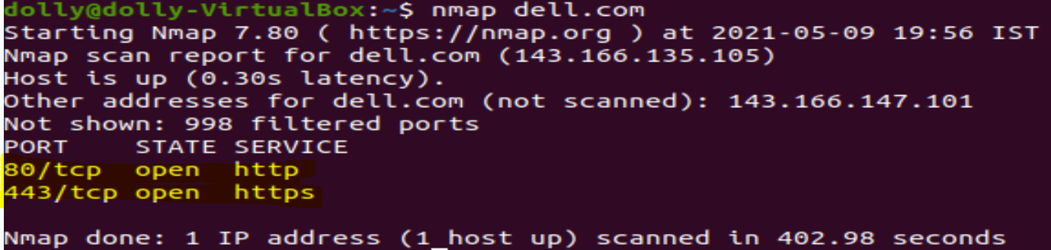
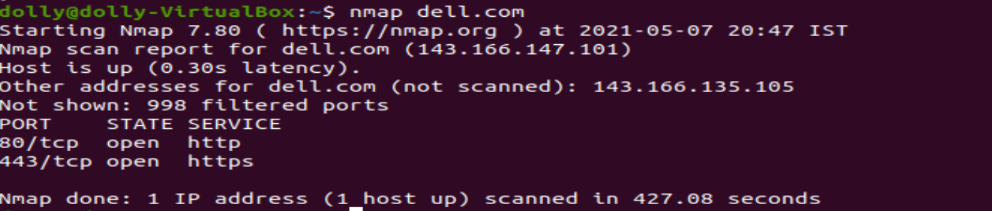

Slide 21
nslookup
•Short for “name server lookup,” nslookup gives you a way to research information about a domain name and identify problems. You can also use monitoring tools to help track DNS information.
Try: nslookup
Set type = ns
dell.com
Notes:
nsookup is a tool/client that talks to DNS servers directly

Slide 22
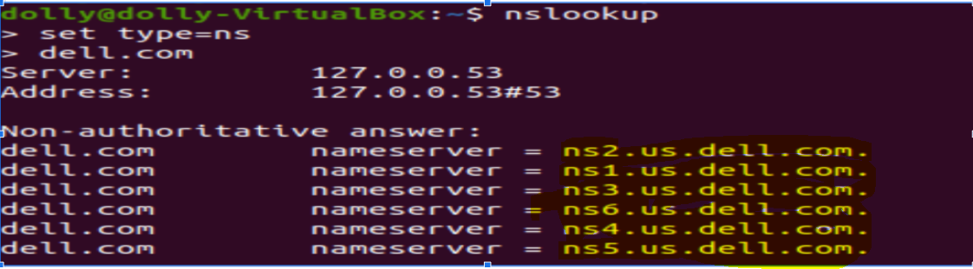

Slide 23
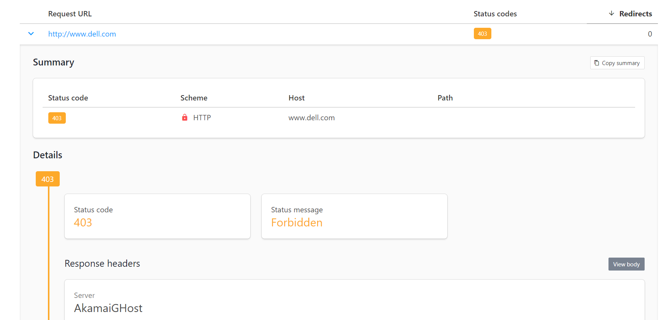
Httpstatus.io
• You can use this tool to easily check HTTP status codes, status messages, response headers, and redirect chains returned by a server in response to a URL request by clients like a browser or search engine bot.https://httpstatus.io/

Slide 24
Domain Name
domain
https://yahoo.com
scheme
top level domain (TLD)
A realm of administrative autonomy, authority or control within Internet.
Any names registered in DNS.
Helps identify resources in the internet.
TLD: domains at highest level of DNS
Reference: https://en.wikipedia.org/wiki/Domain_name
Notes:
URL
A scheme. The scheme identifies the protocol to be used to access the resource on the Internet. It can be HTTP (without SSL) or HTTPS (with SSL).
A domain =
Domain (read script)
Top level domain
‘
one of the domains at the highest level in the hierarchical Domain Name System of the Internet after the root domain.

Slide 25
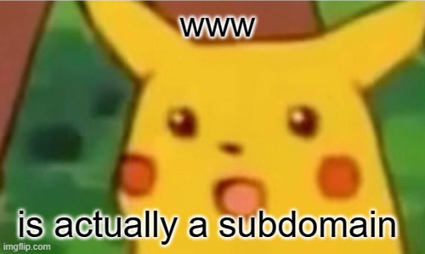
Subdomain
https://www.yahoo.com
subdomain
root domain
Subdomain
A part of another domain
Organise and navigate to different parts of web app and services
Subdomain levels
500 subdomains max
Multiple levels of subdomains e.g. https://www.news.yahoo.com
Reference: https://en.wikipedia.org/wiki/Subdomain

Slide 26
Subdomain
news.yahoo.com.
.
org
com
ca
au
yahoo
spotify
netflix
...
news
finance
...
The hierarchical Domain Name System (DNS)
Notes:
The Domain Name System (DNS) has a tree structure or hierarchy, which includes nodes on the tree being a domain name

Slide 27

Subdomain Enumeration
Find interesting assets of the target:
Servers
Web applications
Find domains/subdomains to increase chances of finding vulnerabilities
Hidden/forgotten applications which may lead to vulnerabilities
Same vulnerabilities can show up across different domains

Slide 28
Sublistr
https://github.com/aboul3la/Sublist3r
Enumerates subdomains using search engines.
Can be installed in Mac, Linux or Windows easily
Requires python and pip
Used in Terminal
Notes:
Open terminal -
Wordlist
Dns part: why https://www.yahoo.com
Point out the subdomain
Word content: common URL path

Slide 29
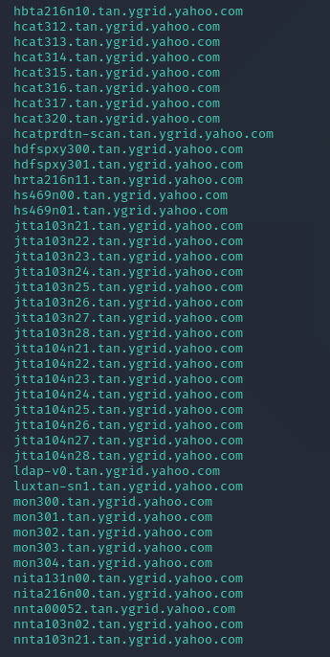
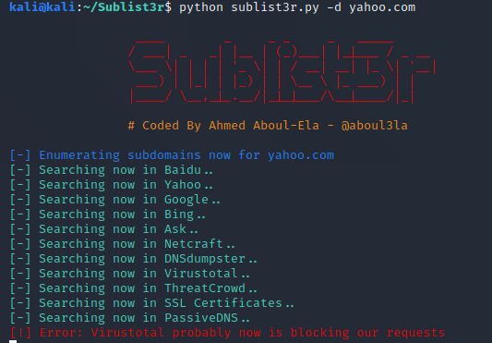
Sublistr
Notes:
Open terminal -
Wordlist
Dns part: why https://www.yahoo.com
Point out the subdomain
Word content: common URL path

Slide 30
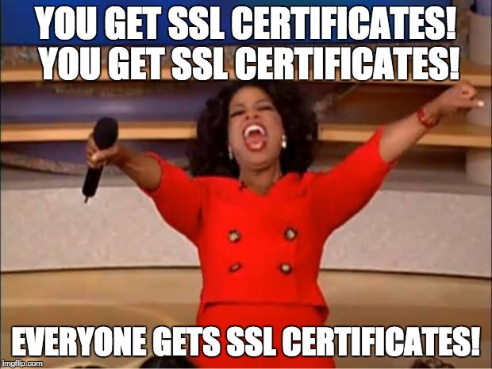

SSL/TLS Certificate
Enables an encrypted connection
Demonstrates ownership of domain from service host
Includes domain name, certificate authority, organisation, expiration etc
Reference: https://www.cloudflare.com/en-gb/learning/ssl/what-is-an-ssl-certificate/
Notes:
type of digital certificate that provides authentication for a website and enables an encrypted connection between client and user
Encryption: SSL/TLS encryption is possible because of the public-private key pairing that SSL certificates facilitate. Clients (such as web browsers) get the public key necessary to open a TLS connection from a server's SSL certificate.
Authentication: SSL certificates verify that a client is talking to the correct server that actually owns the domain. This helps prevent domain spoofing and other kinds of attacks.
These certificates communicate to the client that the web service host demonstrated ownership of the domain to the certificate authority at the time of certificate issuance.1
For an SSL certificate to be valid, domains need to obtain it from a certificate authority (CA). A CA is an outside organization, a trusted third party, that generates and gives out SSL certificates. The CA will also digitally sign the certificate with their own private key, allowing client devices to verify it. Most, but not all, CAs will charge a fee for issuing an SSL certificate.
Once the certificate is issued, it needs to be installed and activated on the website's origin server. Web hosting services can usually handle this for website operators. Once it's activated on the origin server, the website will be able to load over HTTPS and all traffic to and from the website will be encrypted and secure.

Slide 31

Wildcard Certificate
www.yahoo.com
news.yahoo.com
chrome.yql.yahoo.com
br.reseller.ysm.yahoo.com
*.yahoo.com
Certificate can be used with multiple subdomains of a domain.
Pros:
Easy to setup for domain and subdomains
Cons:
If one subdomain is compromised, others will likely be compromised
Notes:
One sentence for cert def
Bad cuz one subdomain compromised (private key is accepted by wildcard one) -> other subdomains can be compromised

Slide 32


GUI Tools
crt.sh
https://subdomainfinder.c99.nl/

Slide 33
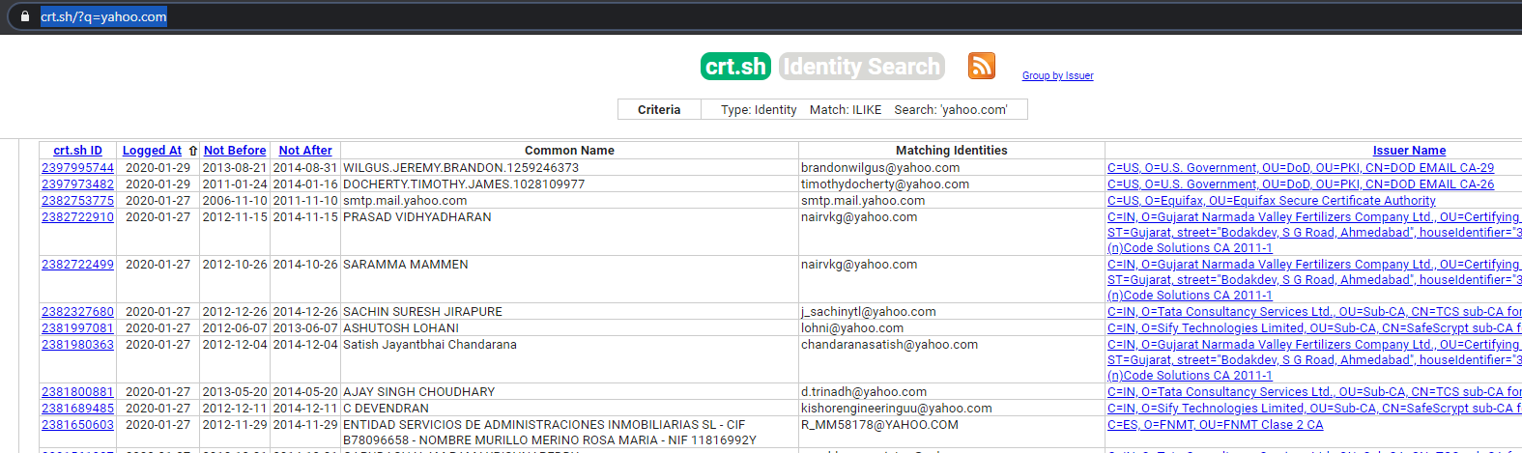
https://crt.sh/?q=yahoo.com
Notes:
Cert related to subdomains

Slide 34
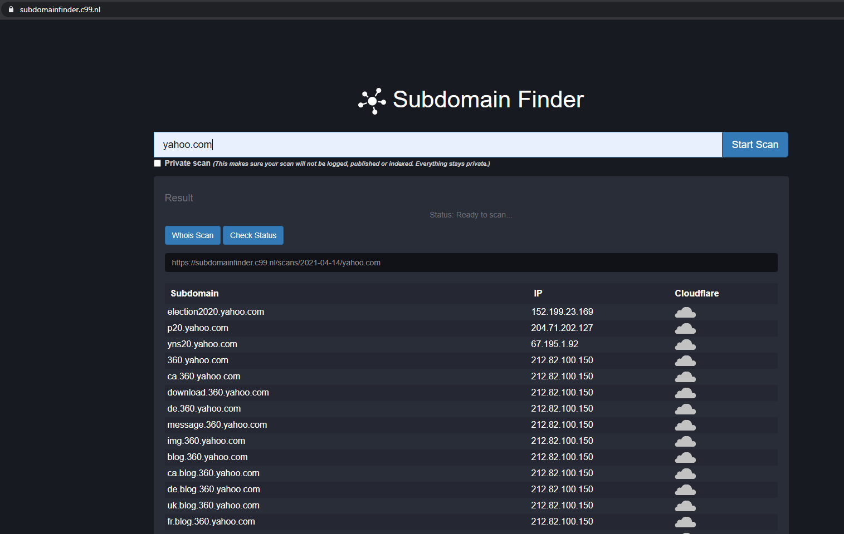
Subdomain Finder

Slide 35

Now it is your turn!
Use https://crt.sh and https://subodmainfinder.c99.nl/ to look up subdomains of yahoo.com
Install sublist3r(https://github.com/aboul3la/Sublist3r) if you complete earlier.

Slide 36



Slide 37
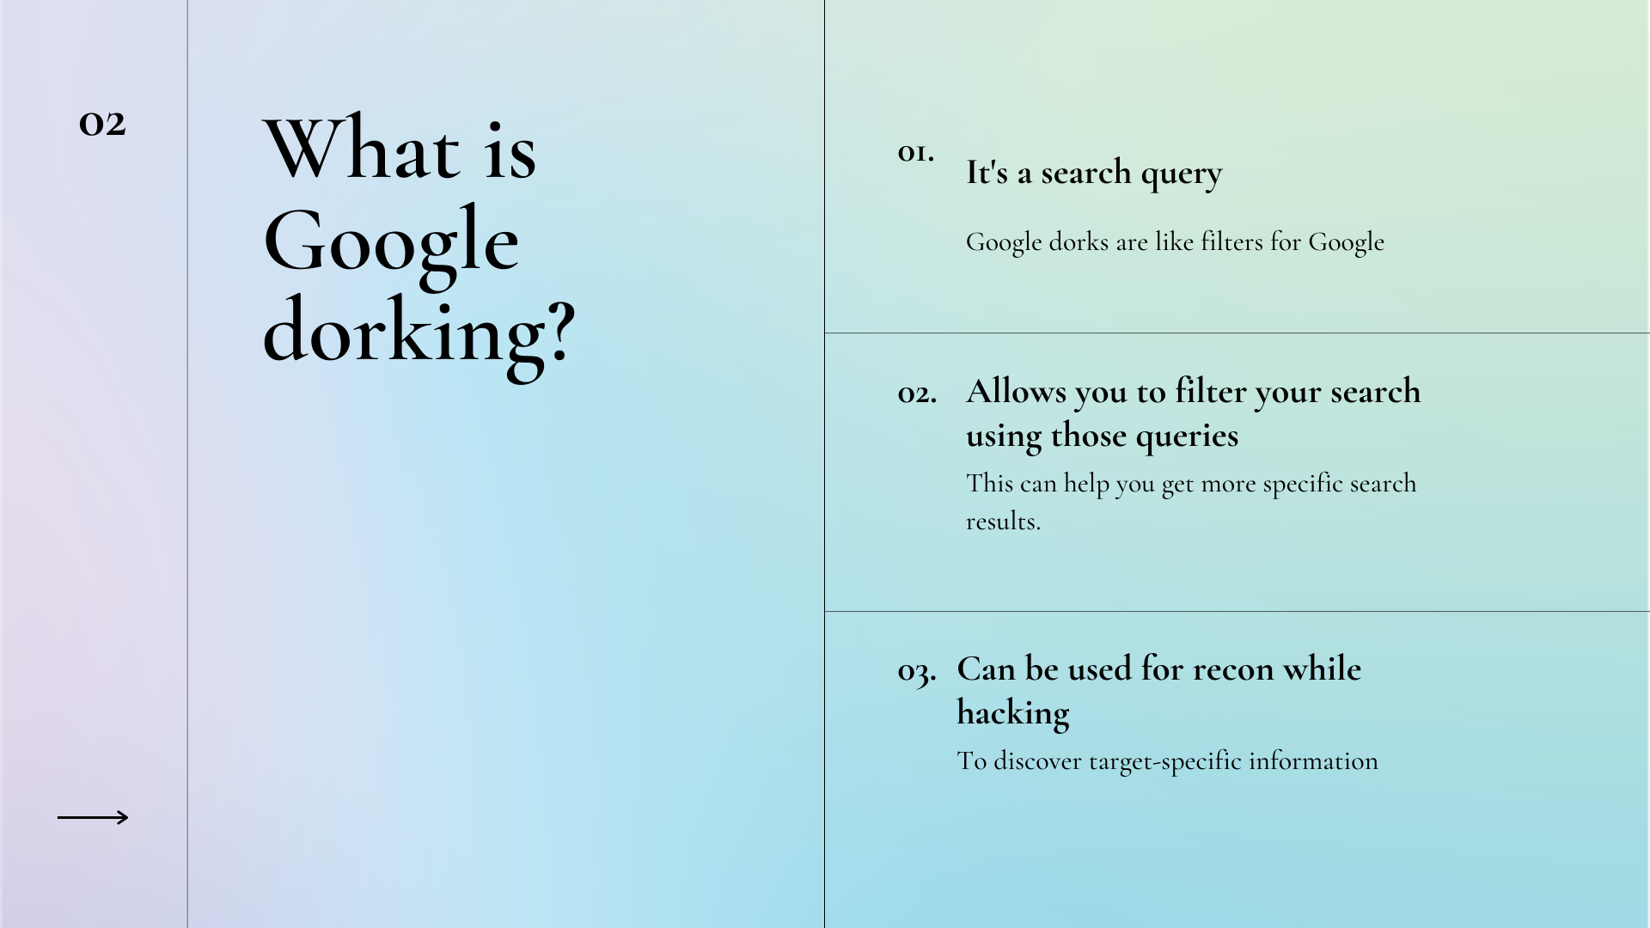


Slide 38
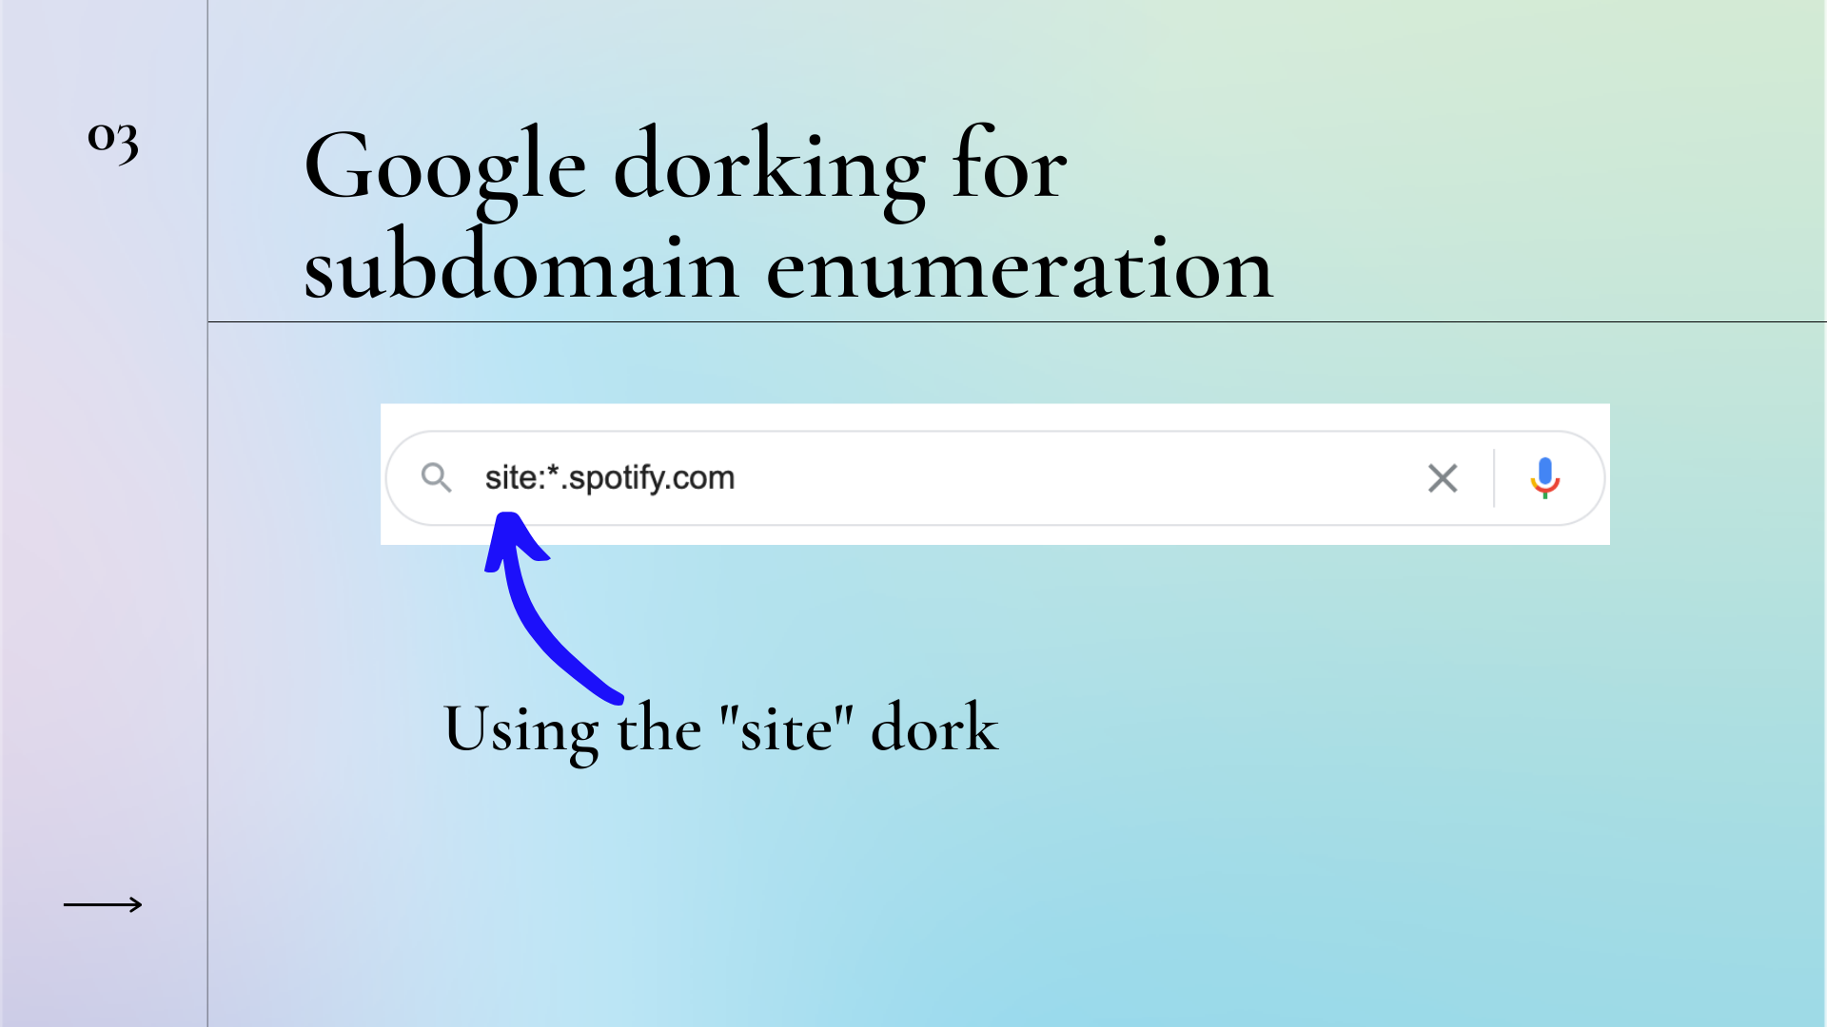
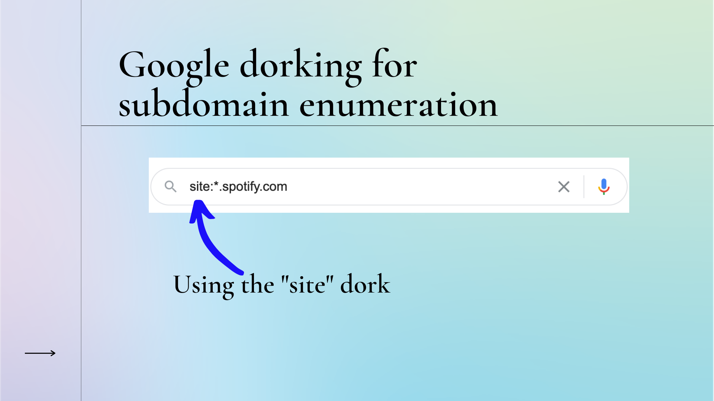

Slide 39
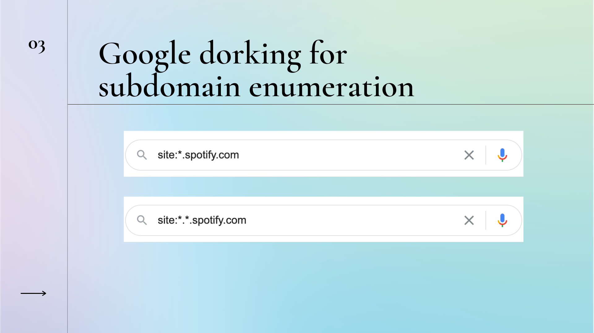
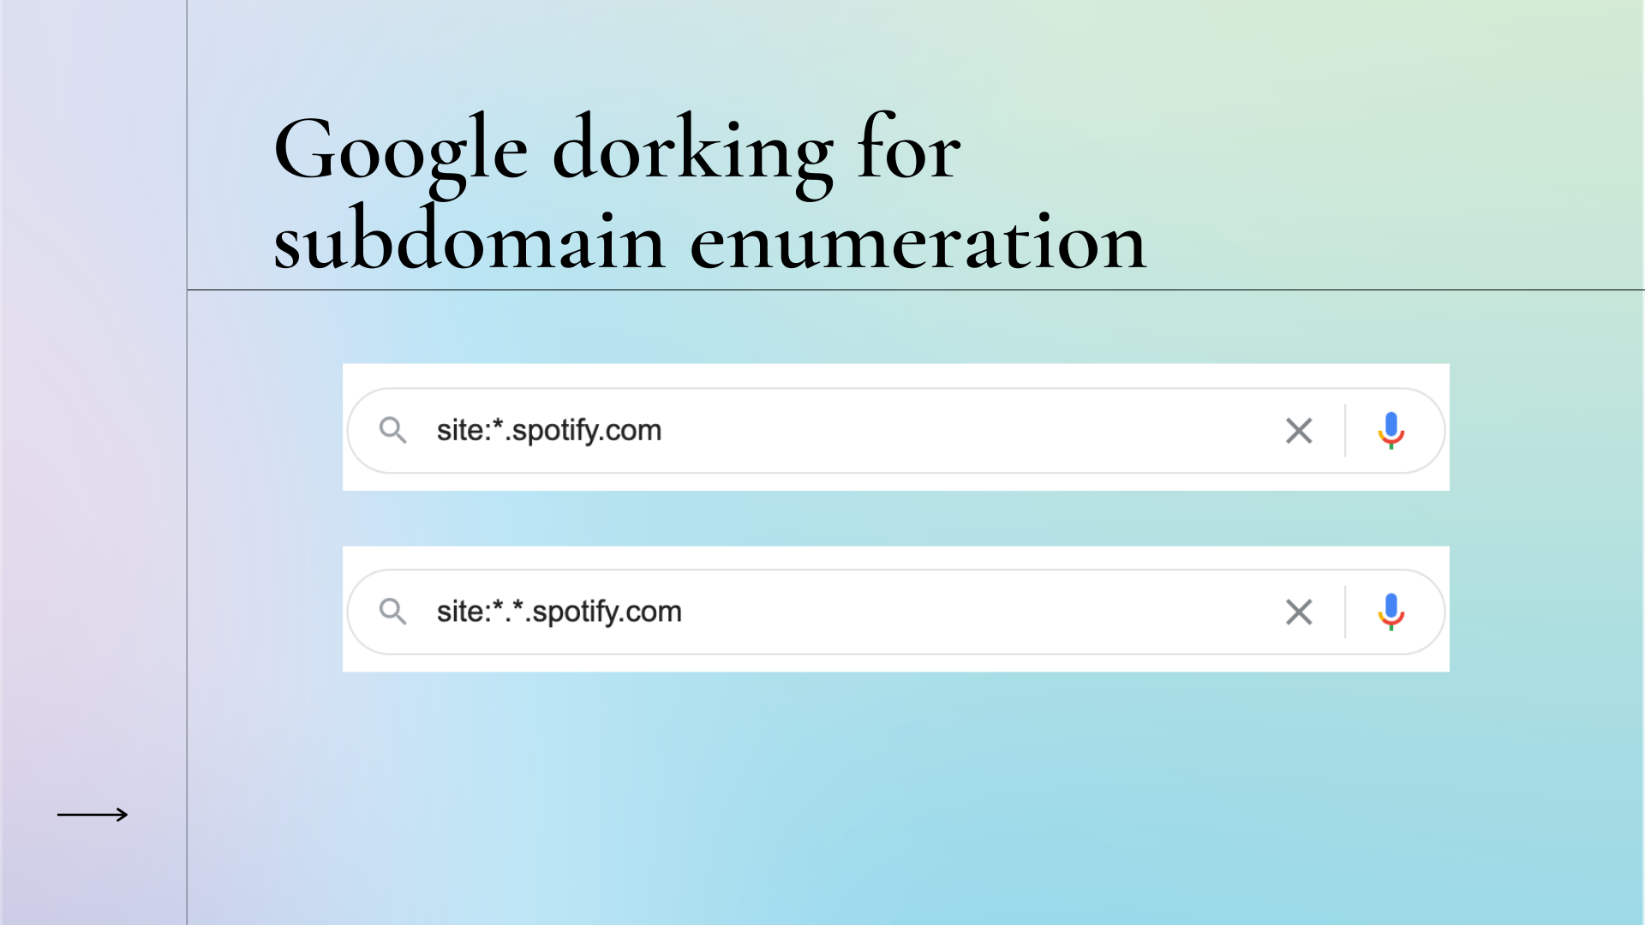

Slide 40
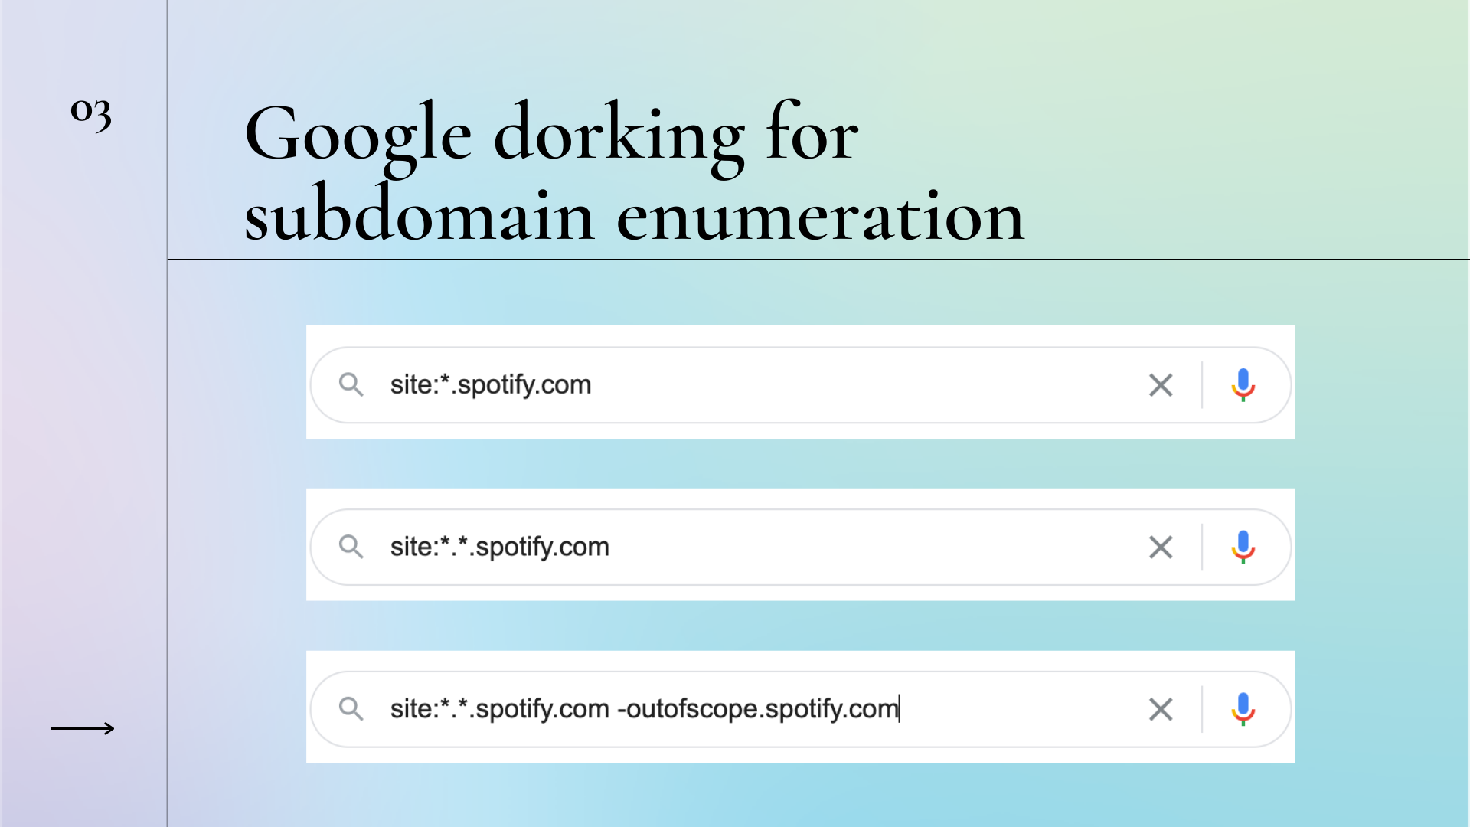


Slide 41
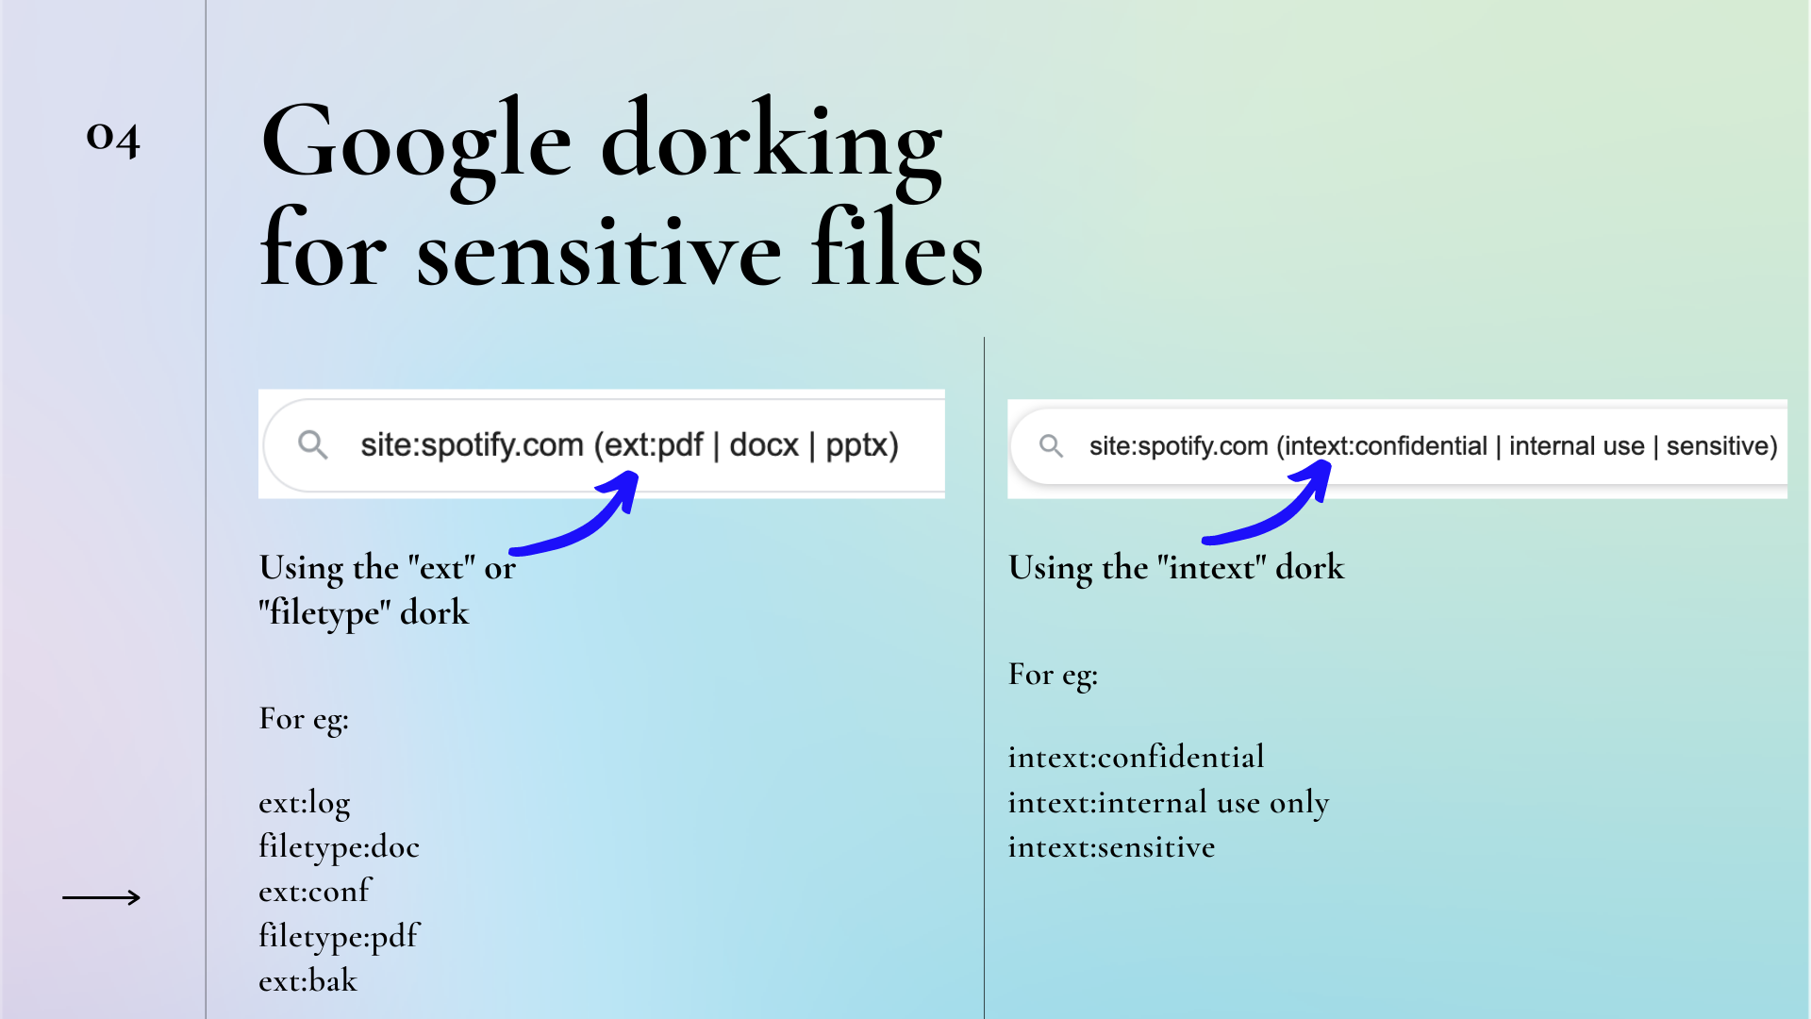


Slide 42
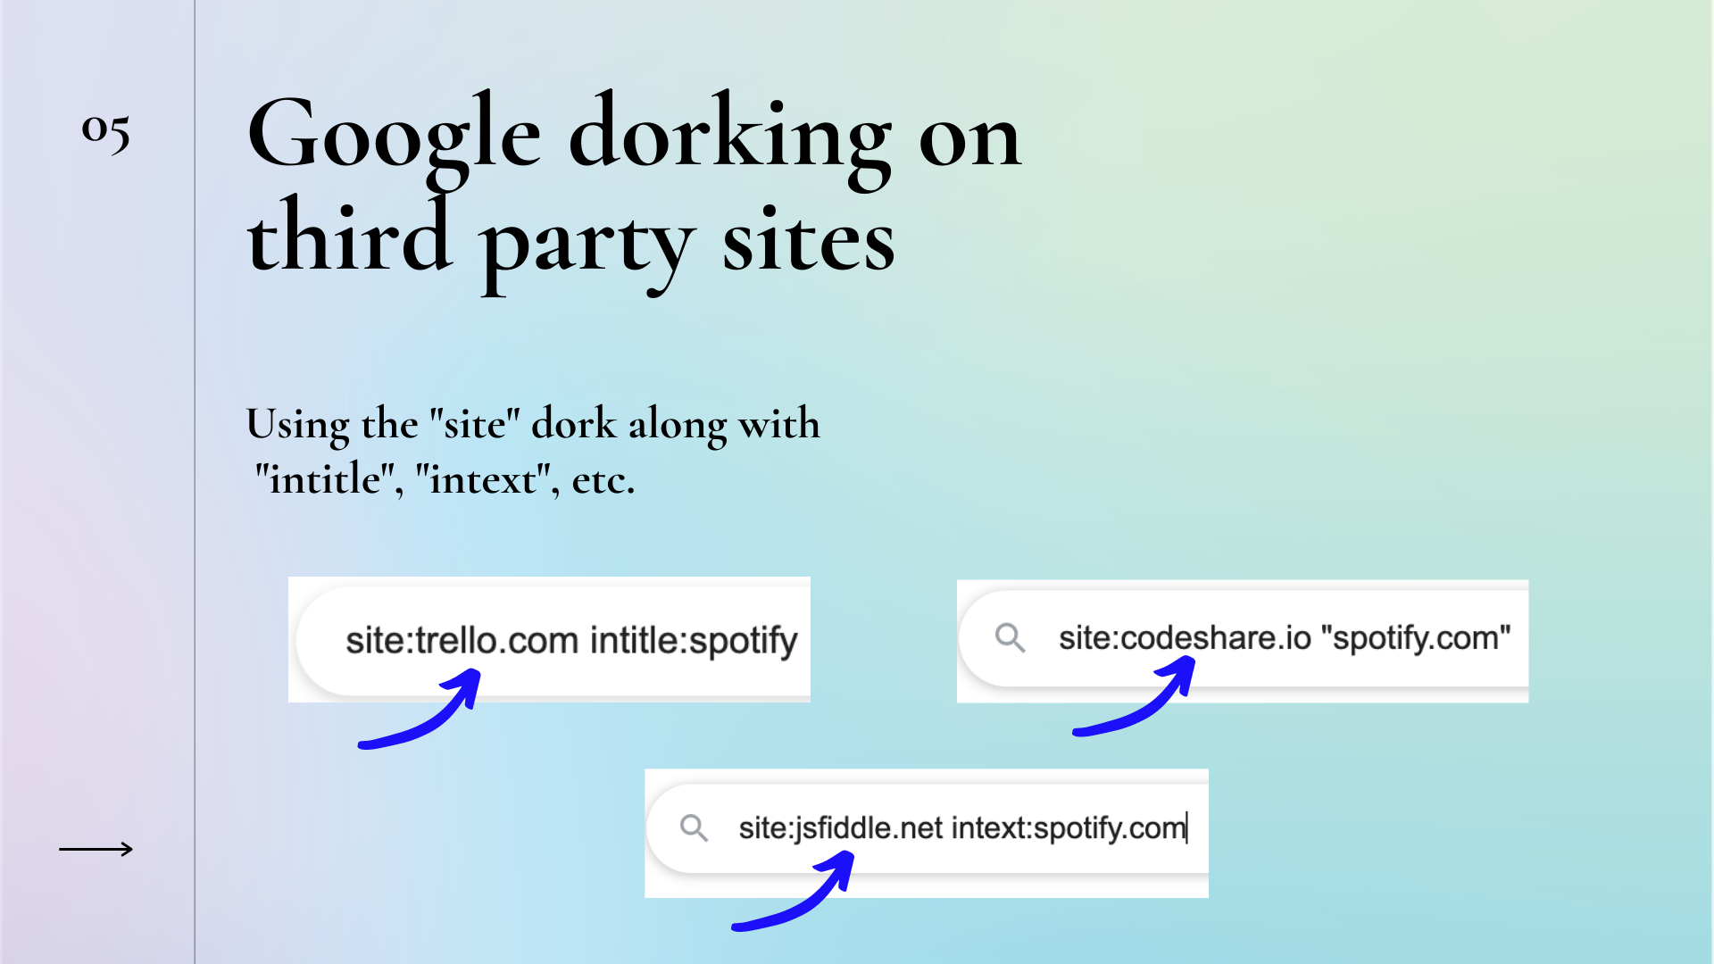


Slide 43
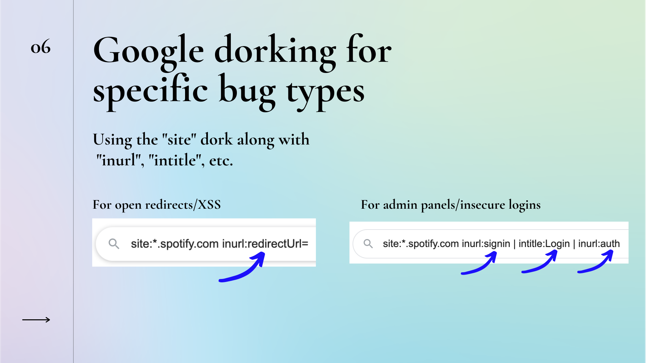
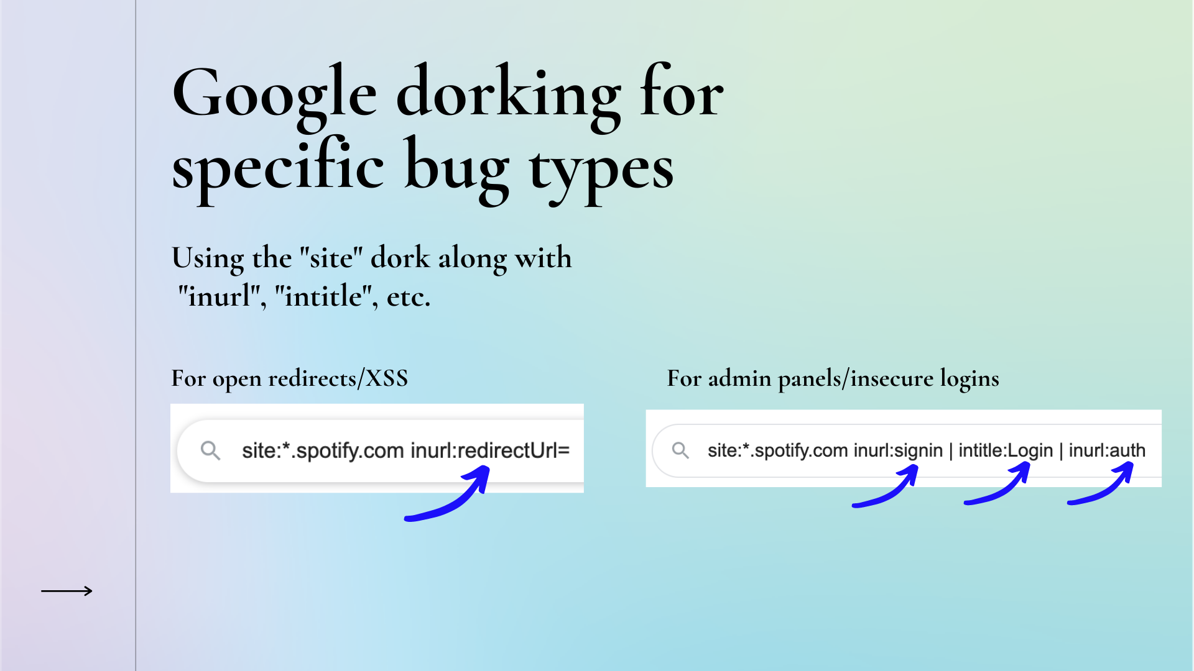

Slide 44



